Slide 1
PRC-1
Batch-14
Vehicle Intrusion Detection using open-cv (python 3.6x) and deep learning
Karthik Vakkalagadda(15L31A05J7)
Ravindra Saragadam(15L31A05H0)
Kavya Manubarthi(16L35A0505)
Balaji Sundarapu(15L31A05I4)
Guide:Sekhar.ch
DEPARTMENT OF CSE

Slide 2
Problems:
PRC-1
What it is all about
Vehicle intrusion detection also know as VID
It is an enhancement for the existing security system
Developed on basis of conventional computer vision and deep learning algorithms
It has the capability of identifying the unauthorized vehicles which trespass in secret areas
DEPARTMENT OF CSE

Slide 3
How we develop?
Development of this project is fragmented to
four different phases
Those are:
Database creation with users data
Analysis using deep learning on streaming video
Query processing verifying the user details
Output generation to security in form of a mail

Slide 4
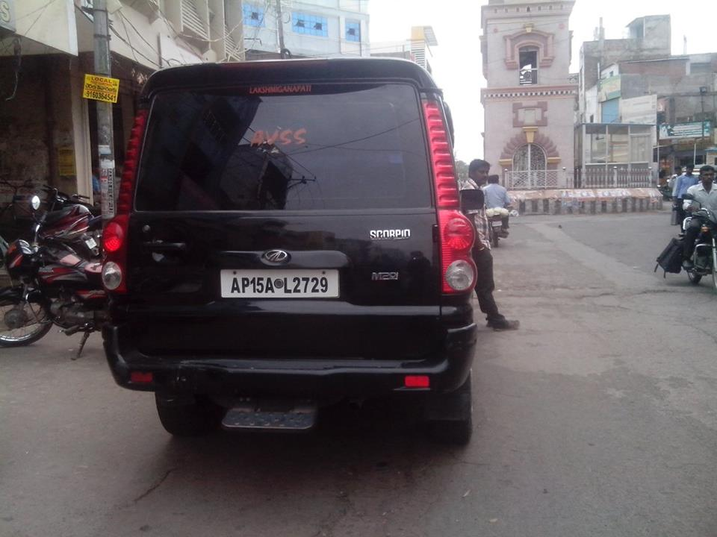
Sample demonstration on authenticated user
Graphic abstraction
Registered person id | Vehicle number
11113 | AP 15 AL 2729
11114 | AP 31 BG 7000
…….. | …….
Authenticated user

Slide 5
Mapping of PO’s
PRC-1
PROGRAM OUTCOMES | MAPPING
PO 1(Engineering Knowledge) | 1
PO 2(Problem Analysis) | 1
PO 3(Design / Development of solutions) | 1
PO 4(Conduct investigations of complex problems) | 0
PO 5(Modern tool usage) | 0
PO 6(The engineer and society) | 0
PO 7(Environment and sustainability) | 0
PO 8(Ethics) | 1
PO 9(Individual and team work) | 1
PO 10(Communication) | 0
PO 11(Project Management and finance) | 0
PO 12(Life-Long learning) | 1
DEPARTMENT OF CSE

Slide 6
Time Line
PRC-1
Time Line of project with stages
Dec : Project Initiation and Planning
Jan : Project Execution
Feb : Project Testing
Mar : Project Documentation
Dead line by the end of semester

Slide 7
Thank you

